Slide 1
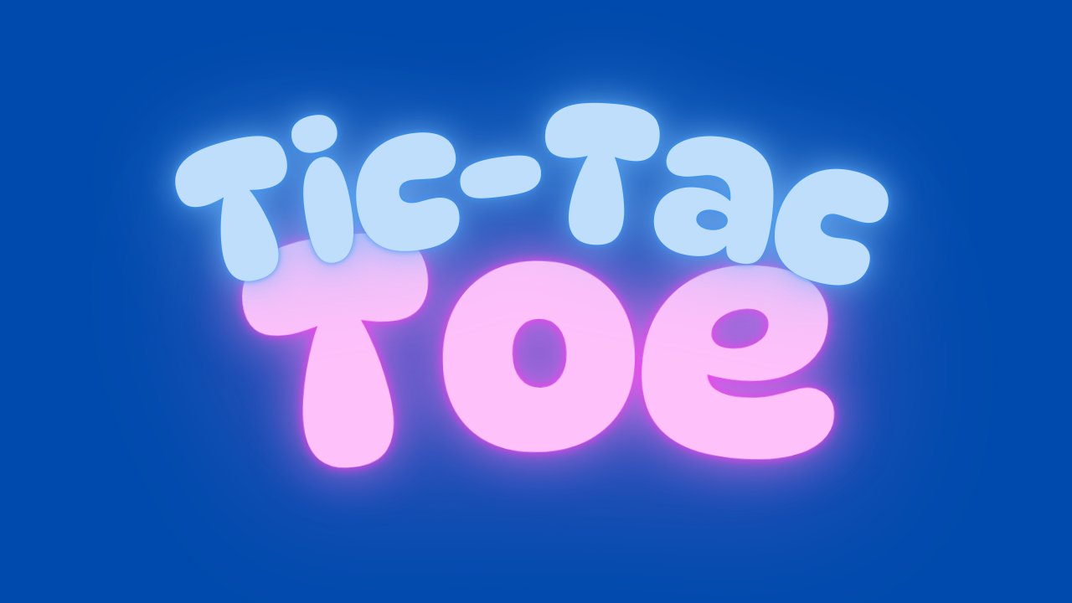
Tic Tac Toe Game in Python
Let's build a simple yet engaging Tic Tac Toe game using Python, a popular language for game development.
by Mansi

Slide 2
Game Objective
Options
Outcome
Player Vs Player
Player Vs AI
Easy
Medium
Hard
Player Vs MaximaAI
Easy
Medium
Hard
Players can take turns, mark the board, and determine a winner or draw.
They can play online by scanning Orcode.

Slide 3
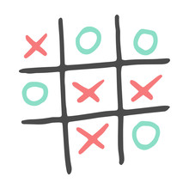
Implementing Tic Tac Toe
1
Design the 3x3 and 5x5 game board.
2
Get player input and validate moves.
3
Update the board with the player's move.
4
Check for a winning condition or a draw.

Slide 4


Creating a GUI (Optional)
Create a Tkinter window.
Add buttons representing the Tic Tac Toe board cells.
Implement functions triggered by button clicks.
Display game progress and outcomes using GUI elements.

Slide 5
Code Snippets
board = [' ' for _ in range(9)]
def display_board():
for row in [board[i*3:(i+1)*3] for i in range(3)]:
print('| ' + ' | '.join(row) + ' |')
def player_move(player):
move = int(input("Enter your move (1-9): ")) - 1
if board[move] == ' ':
board[move] = player
def check_win(player):
win_conditions = [(0, 1, 2), (3, 4, 5), (6, 7, 8), (0, 3, 6), (1, 4, 7), (2, 5, 8), (0, 4, 8), (2, 4, 6)]
return any(board[a] == board[b] == board[c] == player for a, b, c in win_conditions)

Slide 6

Thank You!

